Slide 1
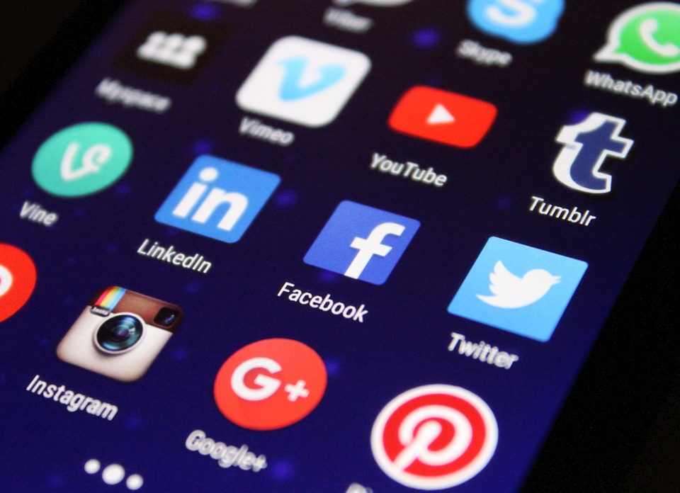
Cyberbullying & Online Safety
Day One

Slide 2
Today’s Goal…
In this cyberbullying lesson, students will:
Recognize the similarities and differences between bullying and cyberbullying
Understand why people may use the online forum for bullying
Learn what is appropriate to share online

Slide 3
Essential Questions
What is a cyberbullying?
How do I respond to cyberbullying?

Slide 4
Warm Up….
Grab a sticky note and write one thing you have learned about Digital Citizenship.
Please put it on the board when you are done.
Notes:
Discuss sticky notes. You can use sentence stems such as…. “Tell me more about that….” The goal is to review what has already been taught in LaCa & assess prior knowledge.

Slide 5

Envelope Activity...
Definition of Bullying…..
Work with your shoulder partner
Notes:
Envelope Activity: Print the definition of bullying in 60 point font & cut apart every 2-3 words. Place them in an envelope. Students will work with shoulder partners to put the strips together to form the definition. You will want to print the definition X times (X= how many groups you will have do this activity).
Definition: “A person is bullied when he or she is exposed, repeatedly and over time, to negative actions on the part of one or more other persons, and he or she has difficulty defending him or herself.”

Slide 6
Bullying is...
Repeated
Intentional
Power-driven
More than a “random act of meanness”
About power & control
Notes:
Bullying comes down to power and control. Everyone likes to feel powerful and in control…. Bullies just seek this in inappropriate ways.

Slide 7
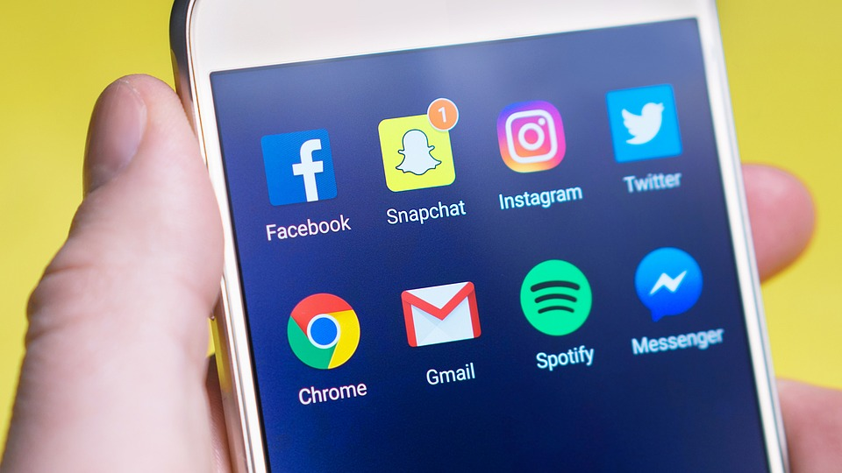
Cyberbullying...
Video: Stand Up to Cyberbullying
Notes:
Today we are going to talk about a different kind of bullying that is becoming more and more common cyberbullying.
Click on link for the video

Slide 8
Why do bullies use the internet?
It’s “private”
It feels anonymous (sense of invisibility)
You don’t always get immediate response from the victim
It’s just a “game”
No one is around to stop the sending of the messages (no adults)
It’s not physical
It feels like it isn’t against the law
It feels like you won’t “get caught”/ no immediate consequences for behavior
It feels like you have power over someone else (control of their feelings & actions)
Lack of empathy
Impulsivity
Poor coping skills ( i.e.easily frustrated, difficulty following rules)
To get attention
It’s easier to type out things rather than confronting someone face to face
It may seem like a way to gain social acceptance
Notes:
Facilitate a discussion with shoulder partners or as a whole class group. Touch on the points listed above….

Slide 9
If it’s not okay for a trusted adult to see, you shouldn’t be posting it!!!!!!!
This applies to:
Photos
Videos
“Liking”
Commenting…
ANY ACTIVITY YOU DO ONLINE!

Slide 10

Should I Share?
To share.... or not to share....
Notes:
Click on the link and go through the handout

Slide 11
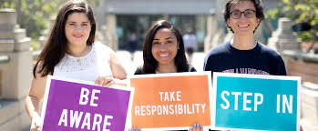
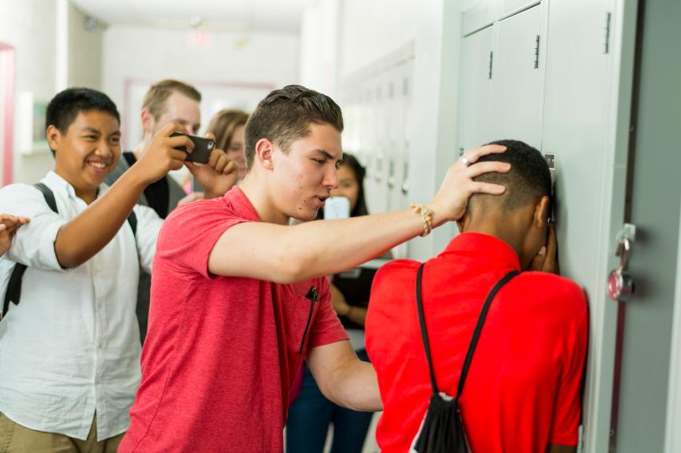

Stand By…. or stand up
Click here for the Class Activity
Notes:
The counselor goes through the activity and shows the class (making the destructive choices) and narrates the consequences of those choices
The students can then do it by themselves on their Chromebooks and make decisions on their own (choices that are realistic as to how they would handle the situation) and see how the situation and its outcome is altered.

Slide 12
Closure...
List as many strategies as you can think of to reduce social aggression.
Notes:
Closure: Review a few of the positive choices from the last activity and have students come up with strategies for reducing online social aggression. You can do this different ways:
Create a question on your google classroom that says, “List as many strategies as you can think of to reduce social aggression.” Have students list these strategies by responding to the question via google classroom.
Students could write their strategies on a notecard and give it to the teacher/counselor at the end of class as an exit slip. The teacher/counselor could compile the list on a Word document or as a poster for the room.

