Slide 1
Restorative Practices
Mike Renn, LMHP, CPC
Lincoln Public Schools

Slide 2
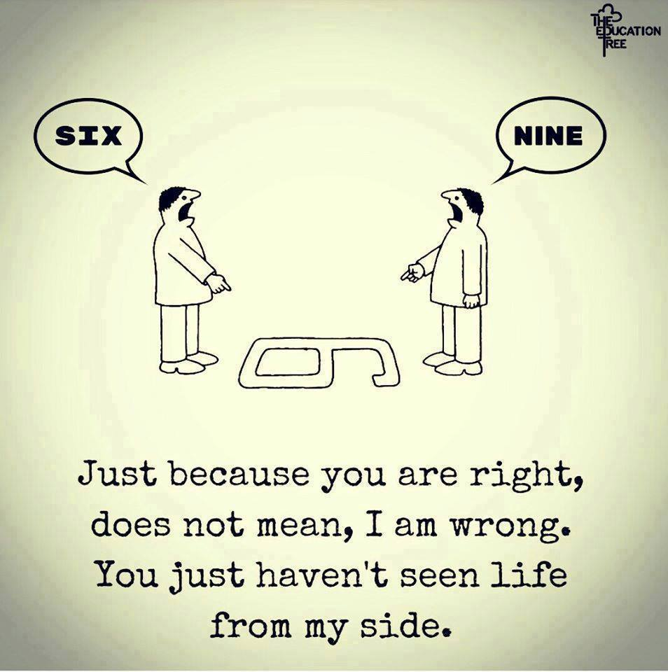
Everyone has a story

Slide 3
Traditional Justice
What law was broken?
Who did it?
How will we punish them?
Restorative Justice
What harm was done?
How can the harm be repaired?
Who is responsible?
Restorative Questions
What was your role in what happened?
What were you thinking at the time?
What have you thought about since?
Who do you think has been affected? How?
What do you need to do to make things as right as possible?
How can we make sure this doesn’t happen again?
What support do you need?

Slide 4
 | PUNITVE | RESTORATIVE
Misbehavior is defined by… | Breaking school rules; disobeying authority | Harm done to one person/group by another.
Process relies on… | Authority figure establishing what rules are broken and who’s to blame. | Everyone working to problem solve, build relationships, and achieve a mutually-desired outcome.
Accountability defined as… | Receiving punishment | Understanding the impact of actions, taking responsibility for choices, suggesting ways to repair harm and restore community.
Goal of response… | Pain or unpleasantness to deter/prevent. | Meaningful restitution to reconcile and acknowledge responsibility for choices.
Effects of response… | Short term – behaviors often stop in the moment but return once the punishment is over. | Long term – students learn crticial social and emotional skills that serve them in college, career, and life

Slide 5
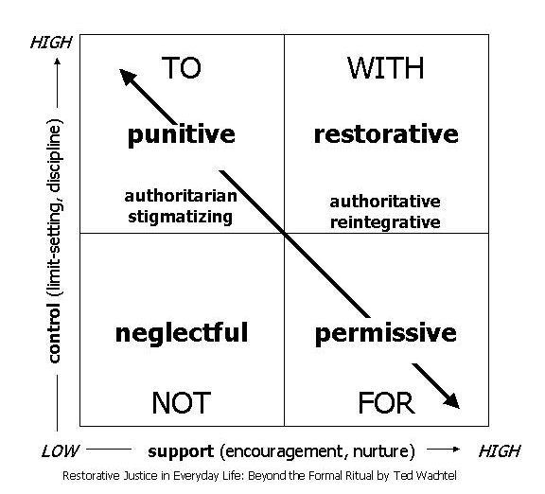
The Restorative Mindset Map
Notes:
Human beings are happier, more productive and more likely to make positive changes in their behaviour when those in positions of authority do things WITH them, rather than TO them or FOR them.
The building of social capital and achieving social discipline through participatory learning and
decision making.
Now for us folks in authority, that can be hard to do at times. After all, we are the ones in authority, and now you want me to give it up?
When my husband tries to exert authority over me I tell him, “you’re not the boss of me”. We resist authority.
"Restorative justice represents a paradigm change from thinking about justice as a mechanism for social control to thinking about justice as a mechanism for social engagement.
We know that people who are engaged in healthy ways socially and emotionally make better decisions, and so restorative justice seeks to be socially and emotionally intelligent justice."

Slide 6
“TO” vs. “WITH” Social Discipline Window
TO – (High control/Low support) – punishment for behavior; top down consequence based on school policy
NOT – (Low control/Low support) – ignoring behavior, not responding.
FOR – (Low control/High support) – Take care of problems and make no demands. Shielding from responsibility for actions. Ignore those who are harmed.
WITH – (High control/High support) – Exercising control, refusing to accept inappropriate behavior, in a caring/supportive way. Assisting them to find ways to change negative behavior and resolve problems constructively. RESTORATIVE!!

Slide 7
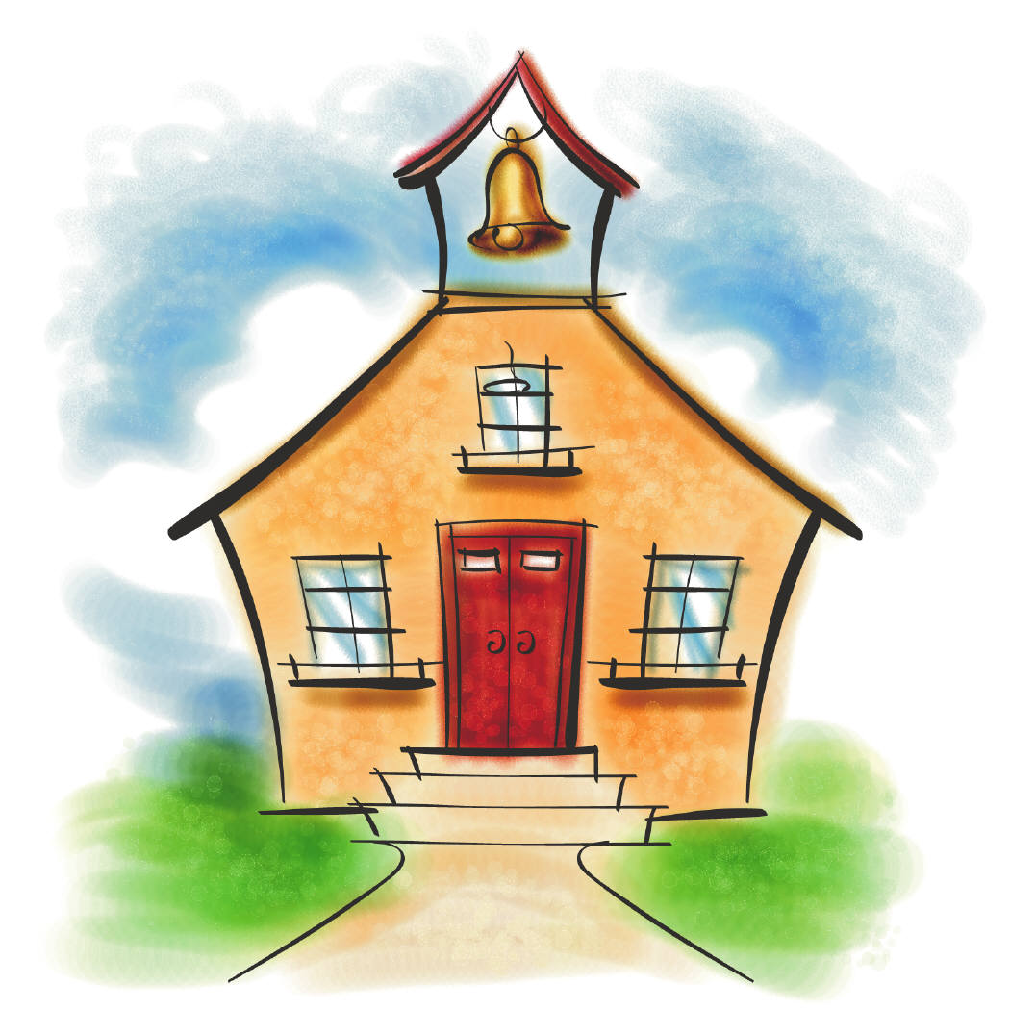
Accountability When a student breaks a rule, they create an obligation to those they have harmed and their community. Learning the lesson. Competency Development Students who misbehave should learn something from the situation and choices they have made. Learning a new skill. Community Safety: There is a responsibility to contribute to the safety of the community by assisting youth in changing their behavior, not simply to punish them. Plan for restitution.
Notes:
There is balance in all 3 areas.

Slide 8
Restorative practice continuum
INFORMAL | TIER 1 | RESTORATIVE LANGUAGE
 | TIER 1 | RESTORATIVE CHATS
 | TIER 1 | CLASSROOM/TALKING CIRCLES
 | TIER 2 | PEER/CONFLICT CIRCLES
FORMAL | TIER 3 | FORMAL CONFERENCE

Slide 9
RESTORATIVE LANGUAGE
Empathetic Listening:
I hear you saying that you are still upset about what happened. Although I am upset too, I want to hear your side of things. Go ahead and tell me what’s on your mind.
“I” statements:
When I heard you speaking to Kyle in the way you did, I felt frustrated because I value the respect that we’ve built in this classroom
Restorative Questions:
What happened?
What were you thinking and feeling at the time?
Who do you think has been affected? How might they be affected?
What do you think you need to do to make things right?

Slide 10
EMPATHETIC LISTENING – “Listen with your eyes, heart, and ears”
How to: “Ask yourself”
What is speaker’s posture?
What are their eyes communicating?
How loudly or softly are they speaking?
Which words are being emphasized?
Rationale:
Only 7% of what we communicate is transmitted through words. 40% comes through tone, and the remaining 53% is through body language.
Notes:
EMPATHETIC LISTENING allows the listener to remain non-judgmental and encourages the speaker to remain open and honest throughout any Restorative Practice. Paying attention to tone and body language is just as important as hearing the words a person speaks.

Slide 11
Empathetic listening – “Stand in their shoes”
Rationale:
Even if what we have experienced is similar to someone else, how we experience it may be very different.
How to: “ASK THE SPEAKER”
What is that like for you?
How did you feel when…?
What did you enjoy about…?
What has been the hardest part of…?
Notes:
For instance, a loud, lively classroom activity may be stressful for one teacher and energizing for another.

Slide 12
Empathetic listening – “Practice mirroring”
Rationale:
Repeating the meaning of a person’s words in a warm and caring tone assures the speaker that we seek to understand instead of judging or giving advice
How to: “MIRRORING PHRASES”
Do I understand that you feel…
What you’re saying is…
What I hear you saying is…
I can see that you’re feeling…
Notes:
By mirroring, we can help the speaker better understand him/herself and his/her emotions. In order to listen empathetically, we must be fully present in the conversation and approach what we are hearing from the speaker’s frame of reference.

Slide 13
“I” statements
Encourages and acknowledges ownership over one’s feelings.
DO NOT place blame for the speaker’s feelings. (i.e. “You make me feel…)
Helps strengthen relationships and builds understanding of how actions has an effect on larger community.
Help students see their teachers who have feelings and care.
“I” statement sentence starter
When I see/hear ________
I feel ____________
because I _____________

Slide 14
RESTORATIVE CHAT
WHEN CHALLENGING BEHAVIORS (Harmer)
What happened?
What were you thinking of at the time?
What have you thought about since?
Who has been affected by what you have done? In what way have they been affected?
What do you think you need to do to make things right?
Notes:
This is same as the Restorative Questions. These are used when resolving harm between 2 individuals. Harm does not have to be physical, it can be emotional, spoken words or actions that someone is negatively effected by.

Slide 15
RESTORATIVE CHAT
TO HELP THOSE AFFECTED (Harmed)
What did you think when you realized what had happened?
What impact has this incident had on you and others?
What has been the hardest thing for you?
What do you think needs to happen to make things right?
Notes:
A Restorative Chat, always includes the person or people who have been negatively effected by someone’s actions or words. In a punitive model, the “harmed” are not involved in the process of accountability. Having shared agreements or obligations in class/school sets the course/foundation of having Restorative Chats or Conflict Circles in the future. If we have done the leg work of establishing relationships and agreements with students and staff, THERE WILL BE SOMETHING TO RESTORE! Accountability comes from holding to the expectations of following our agreements and making things right when harm is caused or these agreements are broken. It isn’t about the consequences (punishment) but about repairing the harm and learning a new way to handle conflict.

Slide 16
Communication stoppers
Judgment:
What did you do?
Why would you do that?
You never listen, do you?
You know what happens now, don’t you?
Diagnosis:
The problem with you is that you’re disrespectful.
Demand:
Don’t you talk to me like that!
“Deserve”
Thinking:
He deserves to be punished.
Notes:
DIAGNOSI

Slide 17
Communication pitfalls
Listening Pitfalls
“Multitasking”
Think about what we will say next while they are speaking.
Relating what the speaker is saying to our own experiences.
Judging the speaker or what the speaker is saying.
Response Pitfalls
Letting speaker know if we agree/disagree with him/her.
Too many probing questions before they are ready to share.
Giving advice.
Interpreting speaker’s motives/behavior.
Relating their experience to our own.
Notes:
**Each of these pitfalls may at times be exactly what the speaker wants to hear. It is important to ask the speaker whether or not this type of response is appropriate.

Slide 18
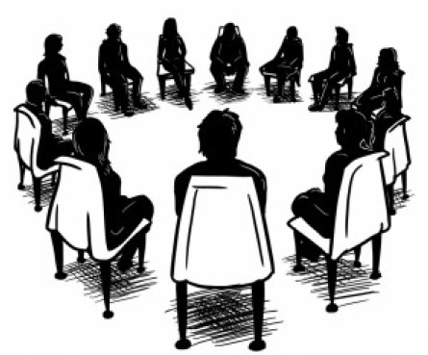
Why We Sit In Circle
They bring people together
Visual contact
Non-hierarchal
Equality of voice
Value based
Fosters connection, inclusion, participation
Consensus building- coming to an agreement we can all be comfortable with

Slide 19
THE CIRCLE PROCESS
Getting Acquainted
Building
Relationships
Exploring Issues/Content/Needs
Taking Action Making Plans

Slide 20
How to use Circles
“Check out”
“Check in”
Classroom norms and Content
Academic goals/teaching curriculum
Behavior problems
Being proactive

Slide 21
Why Restorative Practices in Schools?
Data shows:
Increased attendance
Improved school climate
Improved relationships between students, students & staff and among staff
Improved social-emotional learning
Decreased discipline referrals, suspensions and expulsions
Reduced recidivism

Slide 22
Restorative practice continuum
INFORMAL | TIER 1 | RESTORATIVE LANGUAGE
 | TIER 1 | RESTORATIVE CHATS
 | TIER 1 | CLASSROOM/TALKING CIRCLES
 | TIER 2 | PEER/CONFLICT CIRCLES
FORMAL | TIER 3 | FORMAL CONFERENCE

